Slide 1


CS 153: Concepts of Compiler Design August 25 Class Meeting
Department of Computer Science San Jose State University Fall 2020 Instructor: Ron Mak
www.cs.sjsu.edu/~mak

Slide 2
Reminder: By Wednesday, August 26
Form teams.
Submit your team information into Canvas.
team name
team members and email addresses

Slide 3
Review: It’s All about Translation
Compiler
Translate a source program written in a high-level language to an equivalent program in a low-level language (assembly language or machine code).
Converter
Translate a source program written in a high-level language to an equivalent program written in a different high-level language (e.g., Pascal ➔ Java).
Interpreter
Translate a source program written in a high-level language to actions (i.e., execute the program).

Slide 4
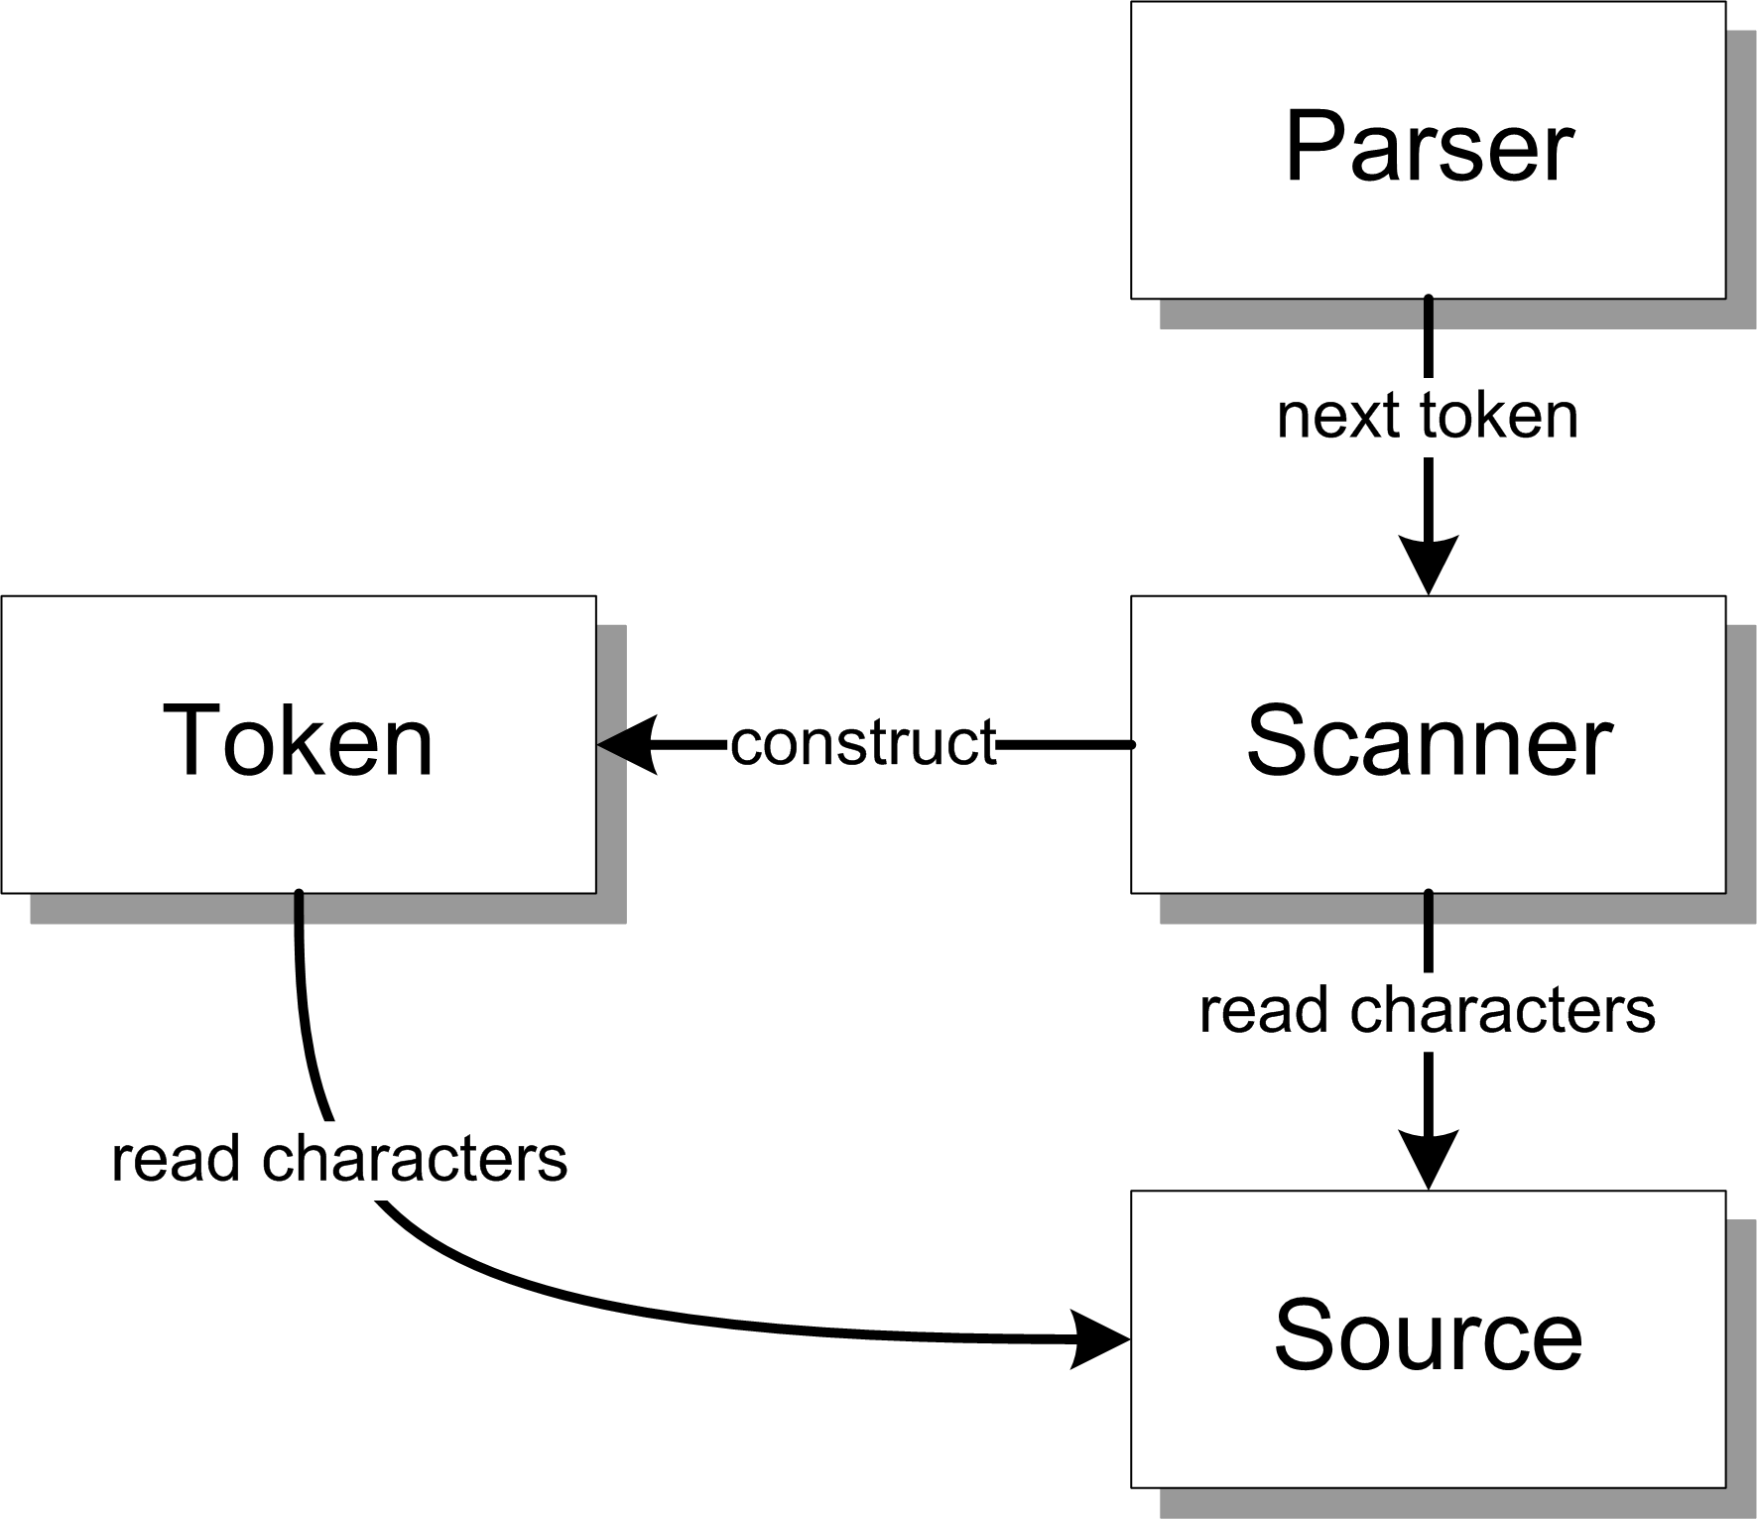
Conceptual Design (Version 1)
Parser
Controls the translation process.
Repeatedly asks the scanner for the next token.
Scanner
Repeatedly reads characters from the source to construct tokens for the parser.
Token
A source language element
identifier (e.g., variable name)
reserved word (IF, FOR, etc.)
number
special symbol (+ - * / = etc.)
Also reads from the source
Source
The source program

Slide 5
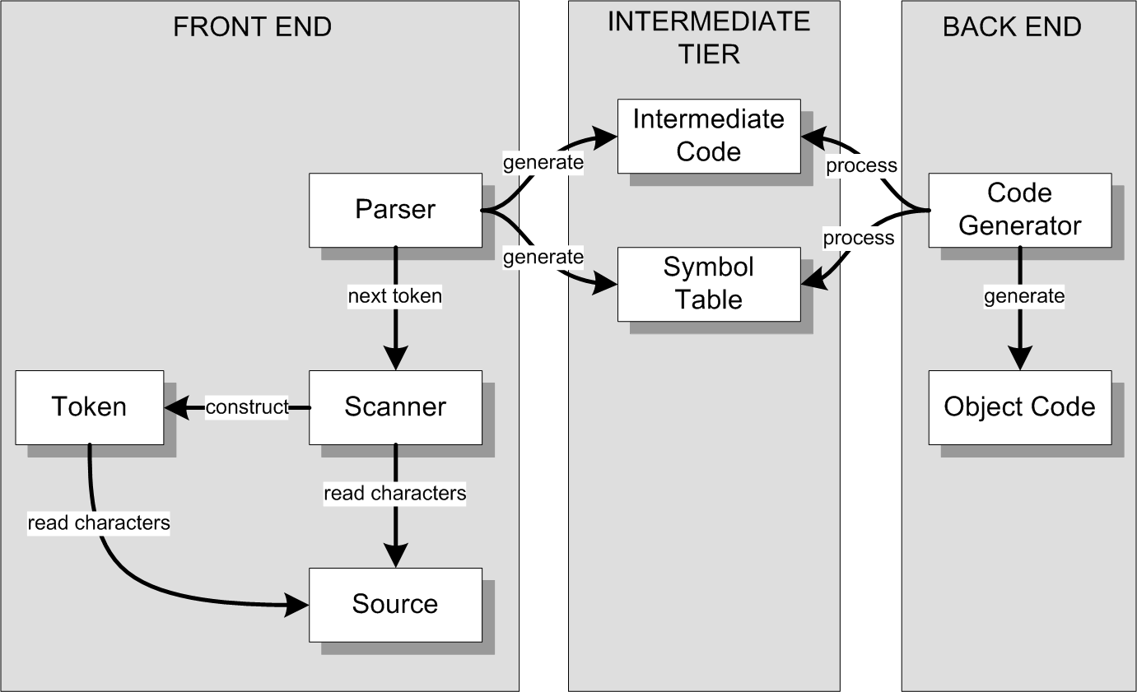
Conceptual Design (Version 2)
We can architect a compiler with three major parts:
Written in a low-level
language such as
assembly or
machine code.

Slide 6
Conceptual Design (Version 2, cont’d)
We can architect a converter with the same parts:
Written in another
high-level language.
We’ll need a different
code generator than
the one in a compiler.

Slide 7
Major Parts of a Compiler or a Converter
Front end
Parser, Scanner, Source, Token
Intermediate tier
Intermediate code (“icode”)
“Predigested” form of the source code that the back end can process efficiently.
Example: parse trees
AKA intermediate representation (IR)
Symbol table (“symtab”)
Stores information about the symbols (such as the identifiers) contained in the source program.
Back end
Code generator
Processes the icode and the symtab in order to generate the object code
Compiler: assembly or machine code
Converter: another high-level language
Only the front end needs to be source language-specific.
The intermediate tier and the back end can be language-independent!

Slide 8
What about Interpreters?
An interpreter executes (or: runs) a source program instead of generating object code.
It executes a source program using the intermediate code and the symbol table.

Slide 9
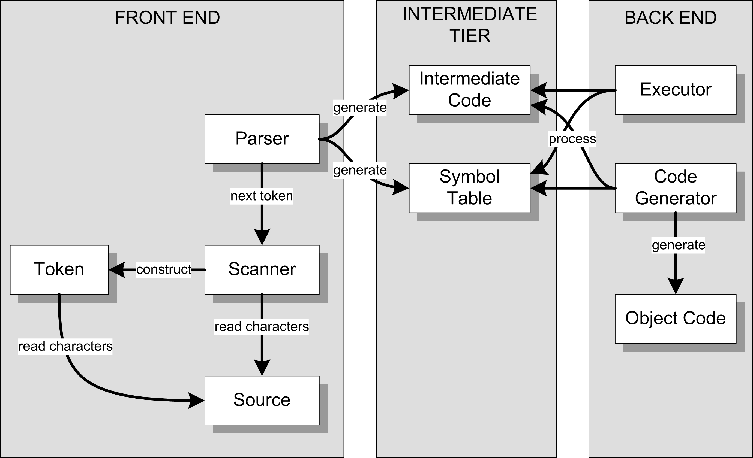
Conceptual Design (Version 3)
Interpreter
Compiler or
converter
A compiler, converter, and interpreter can all use the same front end and intermediate tier.

Slide 10
Comparing Compilers and Interpreters
A compiler generates object code, but an interpreter does not.
Executing the source program from object code can be several orders of magnitude faster than executing the program by interpreting the intermediate code and the symbol table.
But an interpreter requires less effort to get a source program to execute. ➔ Faster turnaround time

Slide 11
Comparing Compilers and Interpreters, cont’d
An interpreter maintains control of the source program’s execution.
Interpreters often come with interactive source-level debuggers that allow you to refer to source program elements, such as variable names.
AKA symbolic debugger
Set breakpoints, single-step, etc.

Slide 12
Comparing Compilers and Interpreters, cont’d
Therefore ...
Interpreters are useful during program development.
Compilers are useful to deploy released programs in a production environment.
In this course, you will ...
Complete an interpreter for the Pascal language.
Complete a Pascal ➔ Java converter.
Develop a compiler for a language of your choice.
You can invent your own programming language!

Slide 13
Take roll!

Slide 14
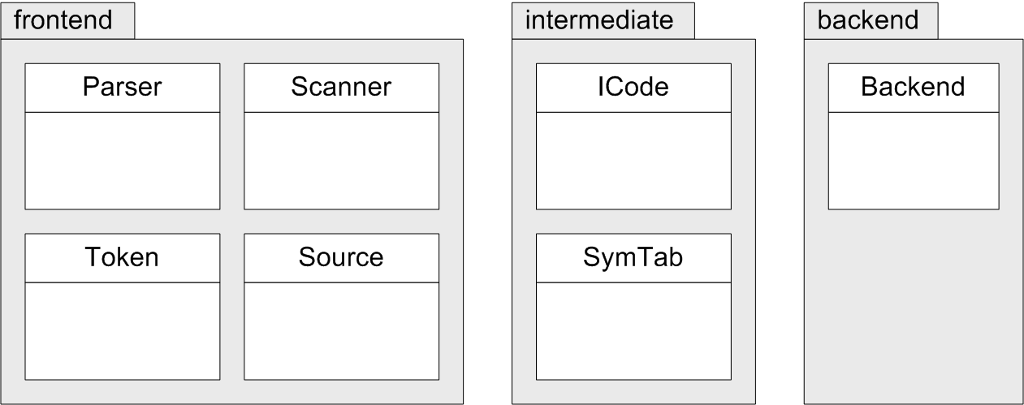
Three Java Packages
FROM:
TO:
Package
Class
UML package and
class diagrams.

Slide 15
Types of Tokens
Identifiers, numbers, and strings
IDENTIFIER, INTEGER, REAL, STRING
Reserved words
PROGRAM, BEGIN, END, REPEAT, UNTIL, WRITE, WRITELN
Special symbols
PERIOD, COLON, COLON_EQUALS, SEMICOLON, PLUS, MINUS, STAR, SLASH, LPAREN, RPAREN, EQUALS, LESS_THAN
Miscellaneous
END_OF_FILE, ERROR
More token types
to come!
Demo

Slide 16
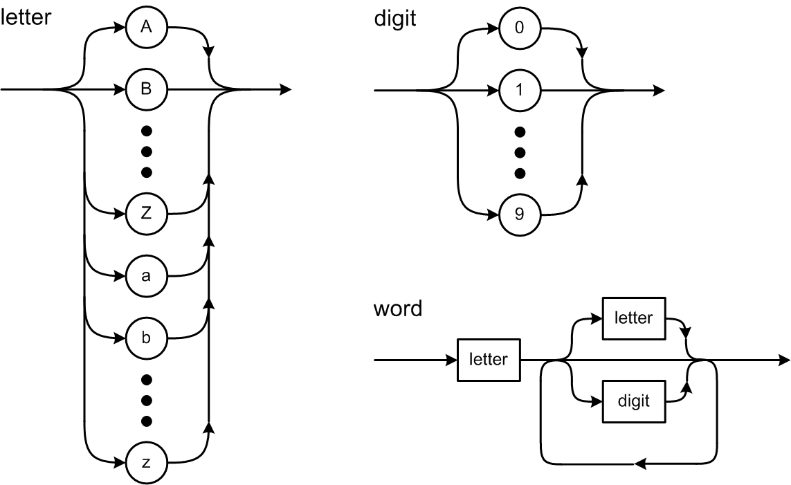
Syntax Diagrams

Slide 17
The Scanner Extracts Tokens
It’s the scanner’s job to extract tokens from the input source file.
Whenever the parser wants the next token, it asks the scanner to extract and return it.

Slide 18
How to Scan for Tokens
Suppose the source line contains IF (index >= 10) THEN
The scanner skips over the leading blanks. The current character is I, so the next token must be a word.
The word token is extracted by reading source characters up to but not including the first character that is not valid for a word, which in this case is a blank. The blank becomes the current character. The scanner determines that the word is a reserved word.

Slide 19
How to Scan for Tokens, cont’d
The scanner skips over any blanks between tokens. The current character is (. The next token must be a special symbol.
After extracting the special symbol token, the current character is i. The next token must be a word.
After extracting the word token, the current character is a blank.

Slide 20
How to Scan for Tokens, cont’d
Skip the blank. The current character is >.
Extract the special symbol token. The current character is a blank.
Skip the blank. The current character is 1, so the next token must be a number.
After extracting the number token, the current character is ).

Slide 21
How to Scan for Tokens, cont’d
Extract the special symbol token. The current character is a blank.
Skip the blank. The current character is T, so the next token must be a word.
Extract the word token and determine that it’s a reserved word.
The current character is \n, so the scanner is done with this line.

Slide 22
Basic Scanning Algorithm
Skip any blanks until the current character is nonblank.
In Pascal, a comment and the end-of-line character each should be treated as a blank.
The current (nonblank) character determines what the next token is and becomes that token’s first character.
Extract the rest of the next token by copying successive characters up to but not including the first character that does not belong to that token.
Extracting a token consumes all the source characters that constitute the token.
After extracting a token, the current character is the next character after the last character of that token.

Slide 23
Test the Scanner
Simple.java
main()
testScanner()
Source.java
currentChar()
nextChar()
Scanner.java
nextToken()
Keep track of the current input character
and read the next character upon demand.
The scanner extracts the first character
of the next token. That first character
determines what type of token is next.

Slide 24
Test the Scanner, cont’d
Token.java
reservedWords table
word()
identifier
reserved word
number()
integer
real
string()
specialSymbol()
Distinguishes reserved words
from identifiers.
Each of these static Token methods
is called by the scanner to create a
token of the appropriate type and
to extract the remaining characters
of the token.

Slide 25
Current Character vs. Next Character
Suppose the source line contains ABCDE and we’ve already read the first character.
currentChar() | A
nextChar() | B
nextChar() | C
nextChar() | D
currentChar() | D
currentChar() | D
nextChar() | E
nextChar() | eol

Slide 26
Consume Characters and Tokens
To consume the current input character, use it (such as by appending it to the text of the current token) and then read the next character.
To consume the current token, process it and then extract the next token.
What happens if you
forget to consume
the current input character
or the current token?

